Slide 1


Geographic Information System
PRESENTED BY
ANKIT GUPTA
ASSISTANT PROFESSOR
DEPARTMENT OF CIVIL ENGINEERING
UNITED COLLEGE OF ENGINEERING AND RESEARCH, PRAYAGRAJ

Slide 2
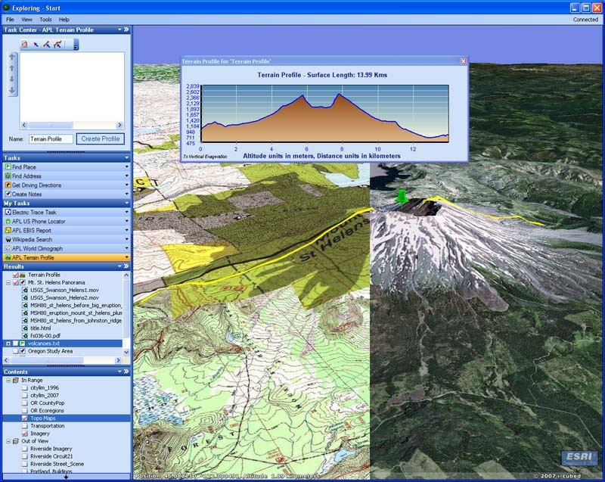
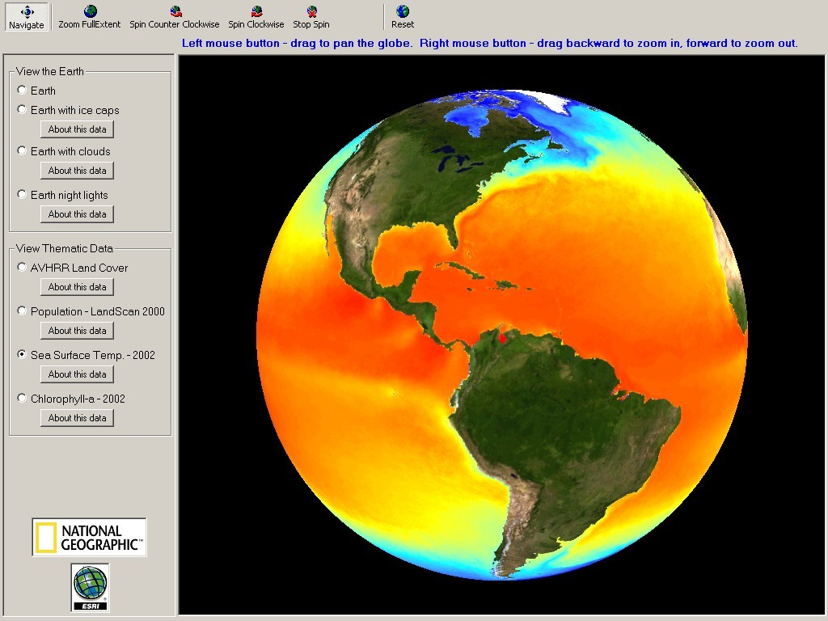
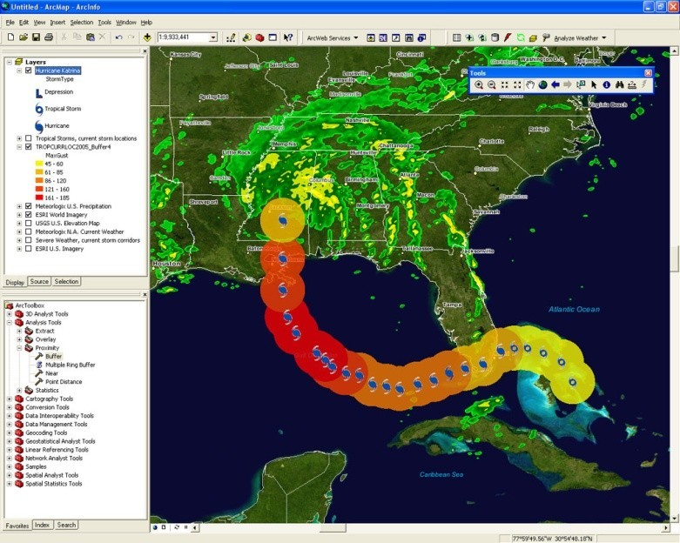

What is GIS?

Slide 3
Geographical Information System
o A set of tools for
Collecting
•
•
•
•
Storing Manipulating Retrieving
Transforming and Display of Spatial Data from the Real World

Slide 4
What is a GIS?
GEOGRAPHIC
implies that locations of the data items are known, or can be calculated, in terms of Geographic coordinates (Latitude, Longitude)
INFORMATION
implies that the data in a GIS are organized to yield useful knowledge, often as colored maps and images, but also as statistical graphics, tables, and various on-screen responses to interactive queries.
SYSTEM
implies that a GIS is made up from several inter-related and linked components with different functions. Thus, GIS have functional capabilities for data capture, input, manipulation, transformation, visualization, combinations, query, analysis, modelling and output.

Slide 5
What is GIS?
GIS = Geographic Information System
Links databases and maps
Manages information about places
Helps answer questions such as:
Where is it?
What else is nearby?
Where is the highest concentration of ‘X’?
Where can I find things with characteristic ‘Y’?
Where is the closest ‘Z’ to my location?

Slide 6
What is GIS?
A technology
– hardware & software tools
An information handling strategy
The objective: to improve overall decision making
6

Slide 7
GIS: a formal definition
“A system for capturing, storing, checking, integrating, manipulating, analysing and displaying data which are spatially referenced to the Earth. This is normally considered to involve a spatially referenced computer database and appropriate applications software”
7

Slide 8
Why is GIS unique?
GIS handles SPATIAL information
– Information referenced by its location in space
GIS makes connections between activities based on spatial proximity
8

Slide 9
GIS Process
Capture Data
Register Map Base
Interpret Data
Store Data in Computer
Convert Data to Digital Format
Process Data
Display Results

Slide 10
Images
Image Processing System
Statistical Reports
Maps
Map Digitizing System
Statistical Analysis
System
Spatial Data Base
Attribute Data Base
Geographic Analysis
System
Database Management System
Statistics Tabular Data
Cartographic Display System
GIS
System
Maps

Slide 11


GIS Areas
Geo Sciences Civil Engineering Transportation Natural resources
Geology & Geophysics Environment Planning Administration Management
Business
Remote Sensing Image processing
Urban & Rural Development
Floods , Disasters Oil exploration
Mines Surveys
Watershed management
Tourism Communications

Slide 12
Softwar es
GIS
ARC INFO
ArcGIS MapInfo GRASS
Geomedia Geoconcept WIN GIS
Microstation AutoCAD
Digital Image Processing
♣ ERDAS Imagine
♣ ER Mapper
♣ ILWIS
♣ ENVI
♣ PCI Geomatica
♣
♣
♣
♣
♣
♣
♣
♣
♣
ArcView image analysis
TNTMIPS
Ecognition

Slide 13
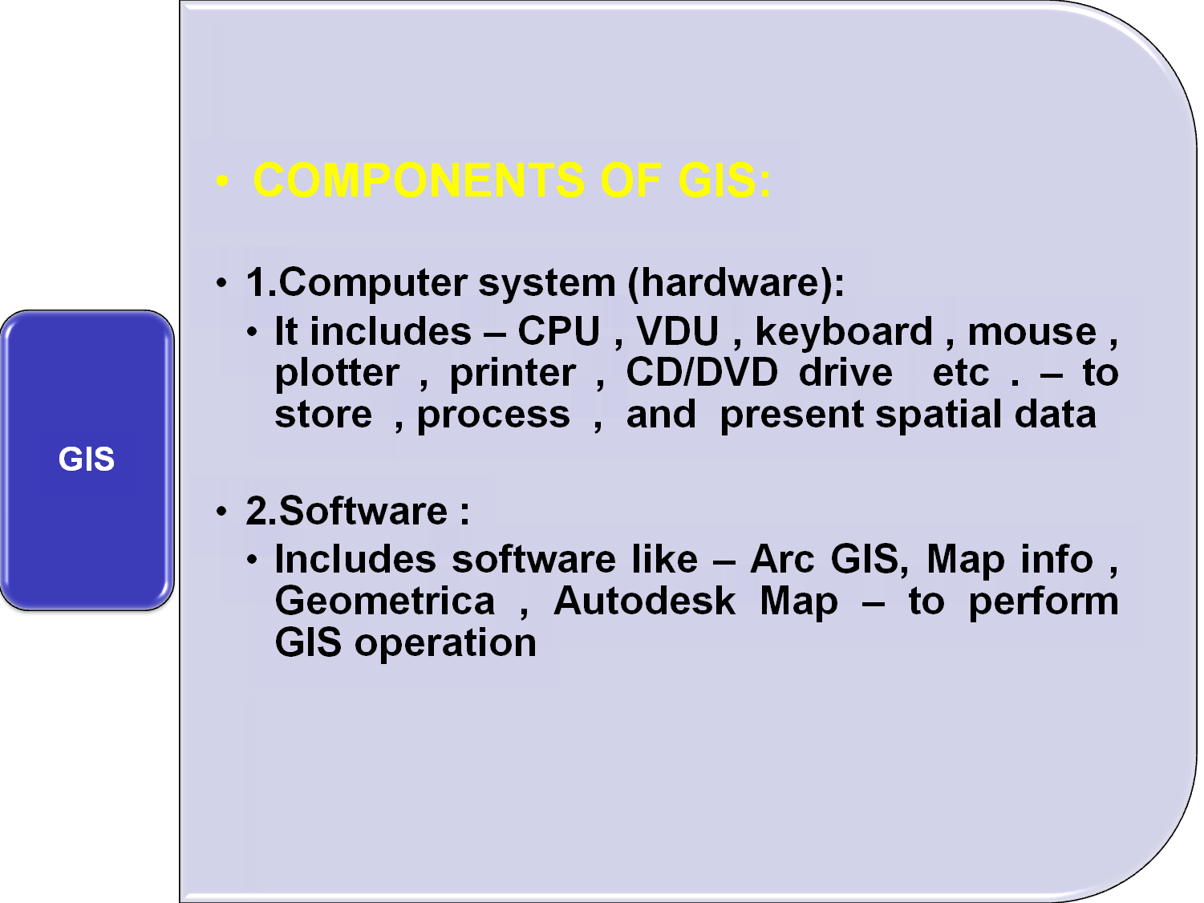


Slide 14
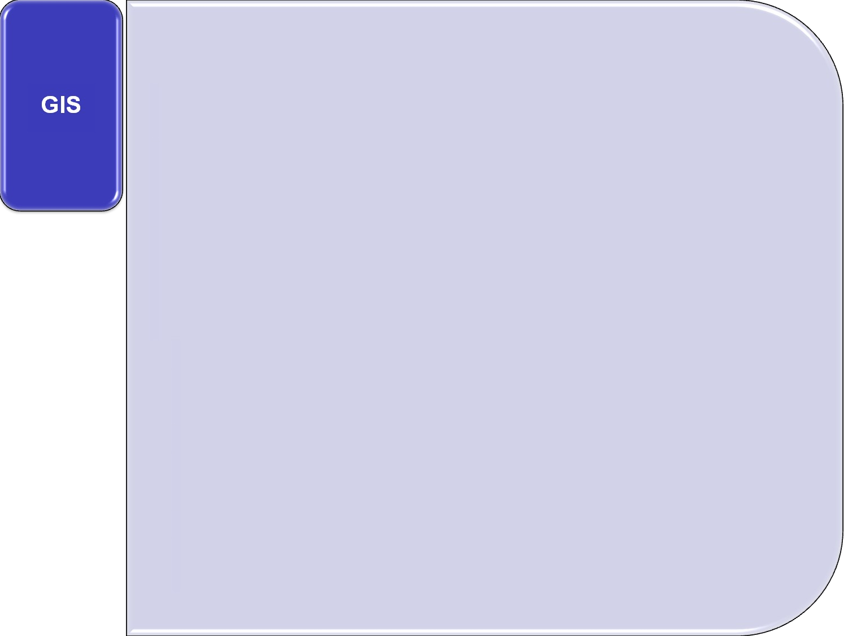

Internal users
input
analysis
Internal data base
Data management
Internal management
External management
GIS
data base
output
External user
External
data base

Slide 15
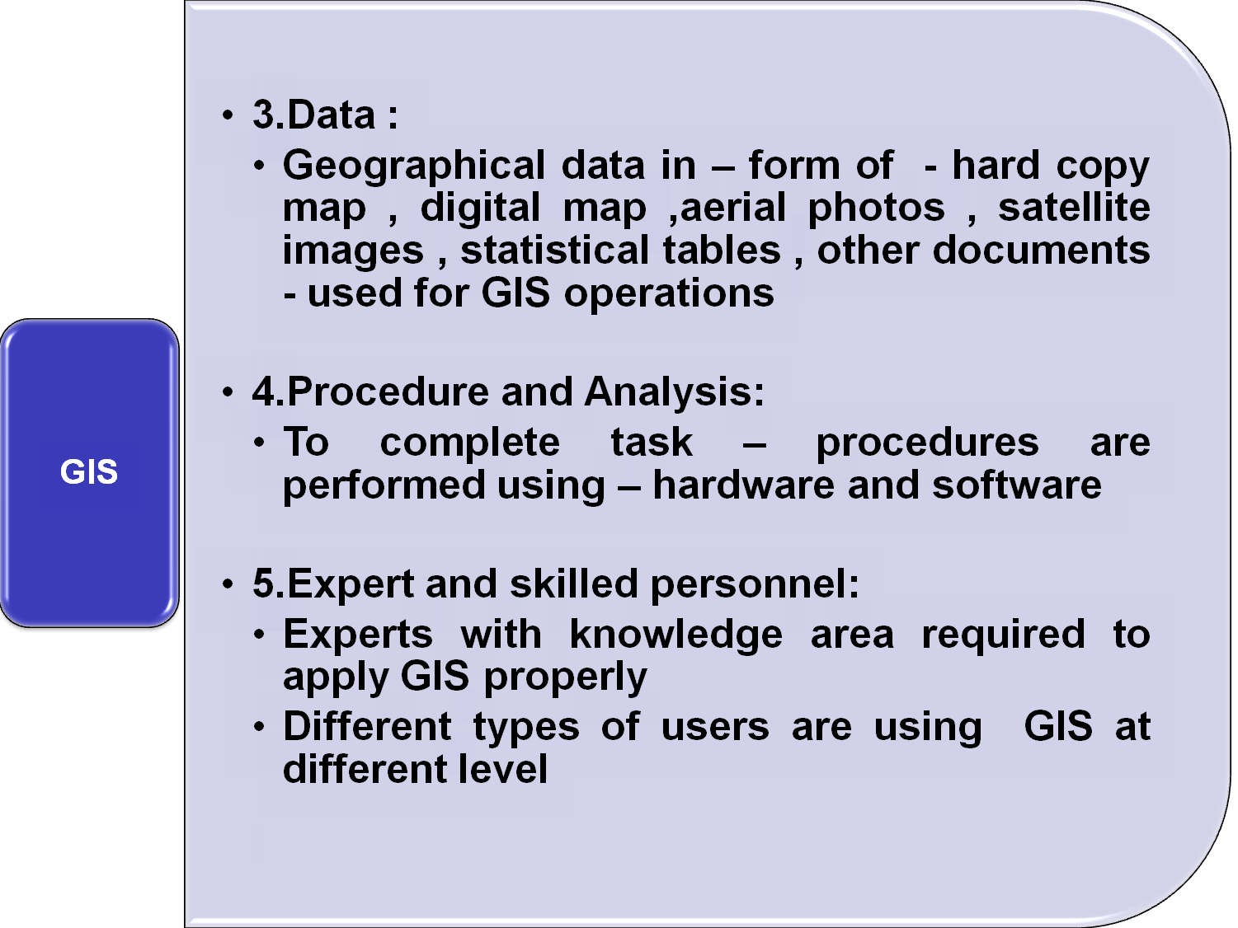

Slide 16
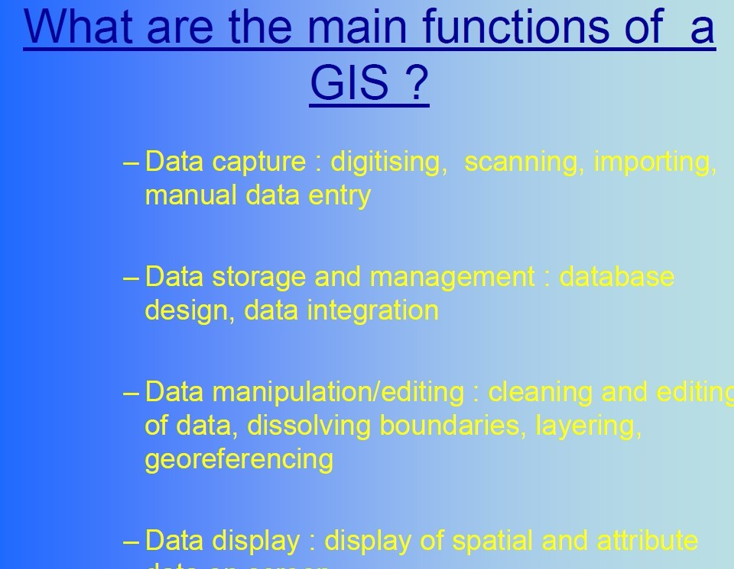
FUNCTIONS OF GIS

Slide 17
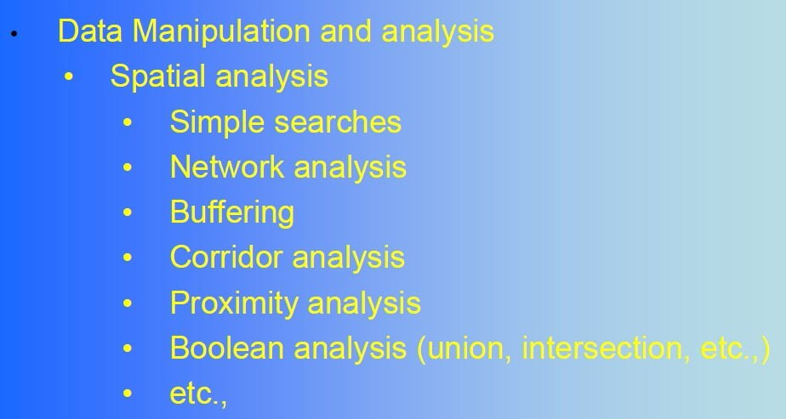

Slide 18
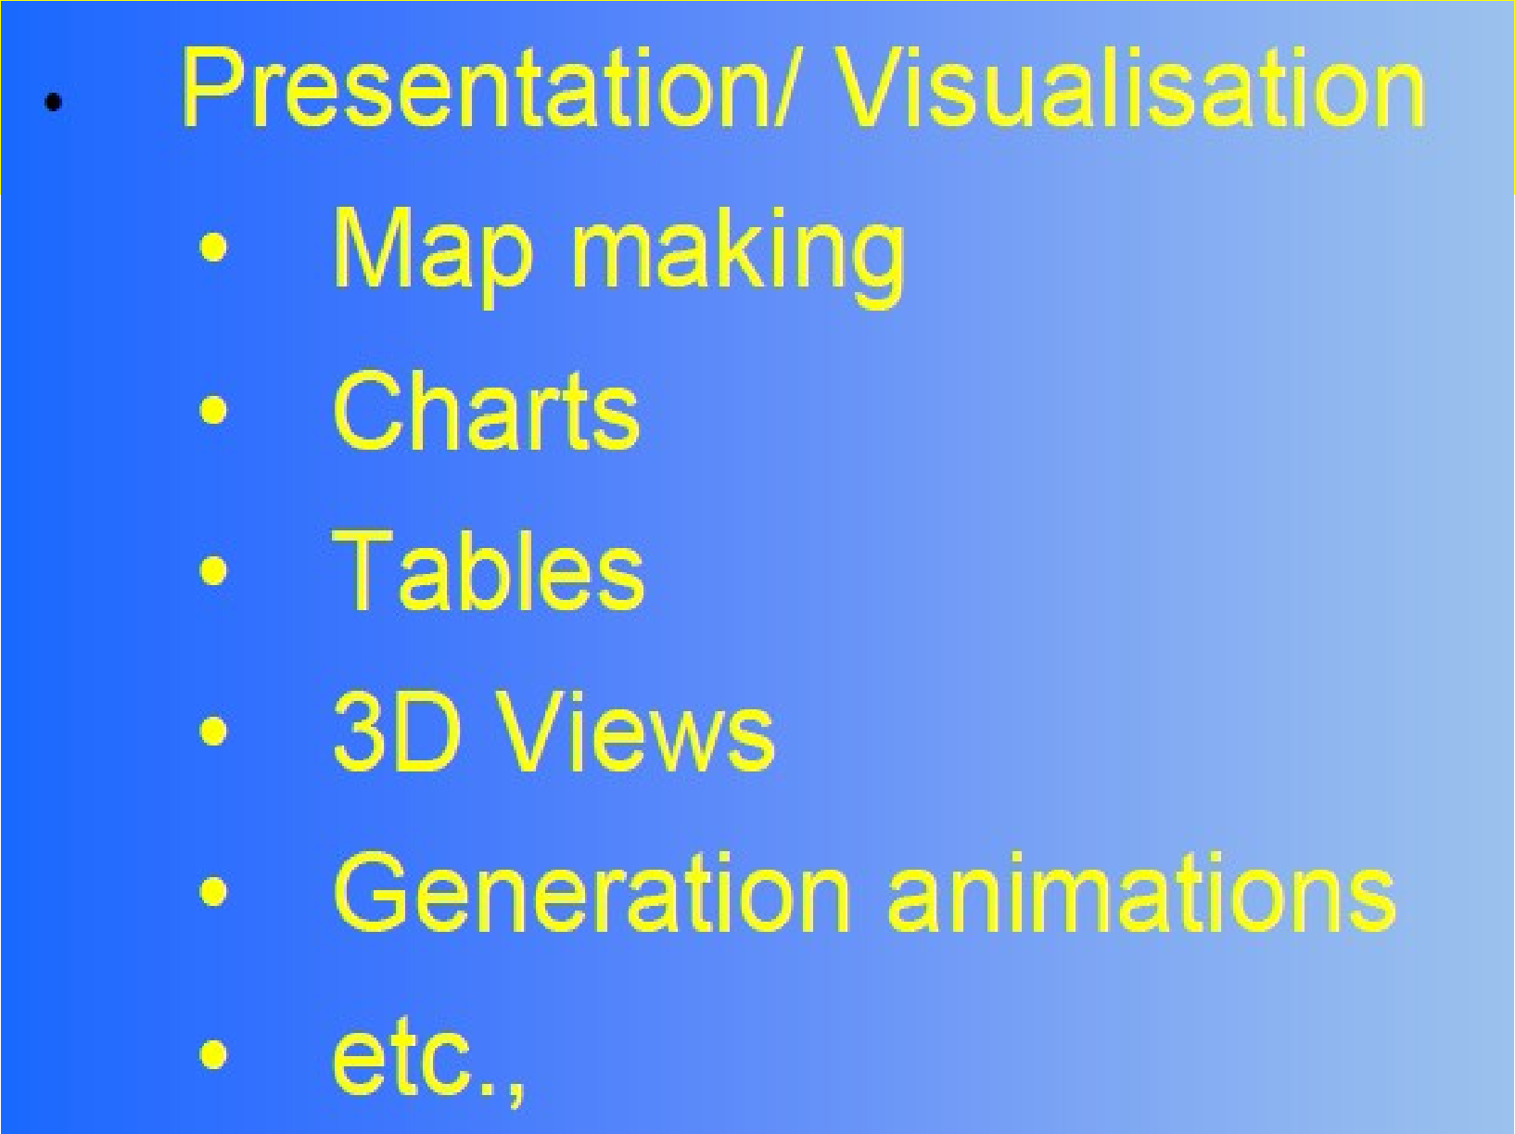

Slide 19
Application of GIS
GIS used in multiple disciplines:
Agriculture
Archaeology Architecture/Landscape Arch. Business
Computer Science Environmental Science
Engineering Journalism Military Science
Natural Resource Management
Geography Geology Meteorology Oceanography Law Enforcement Public Health History Sociology
Urban/Regional Planning

Slide 20
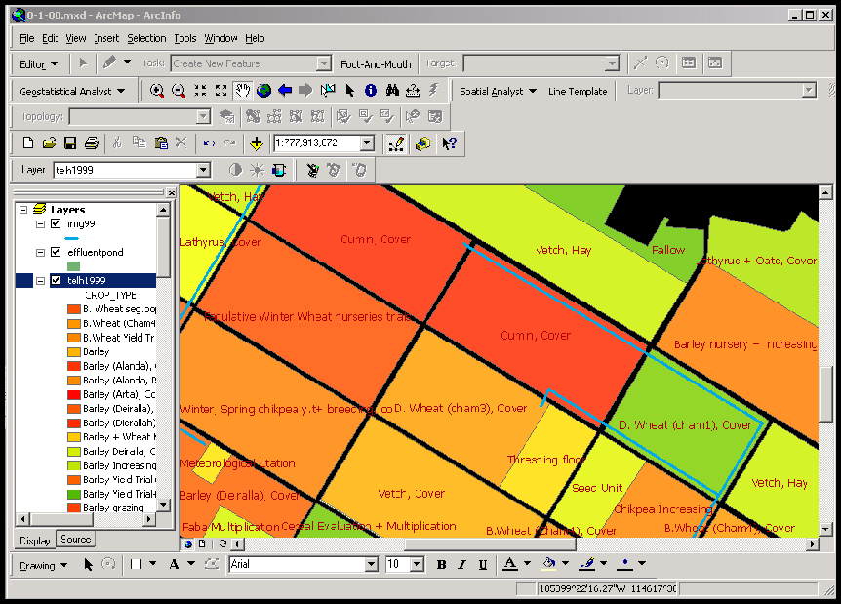
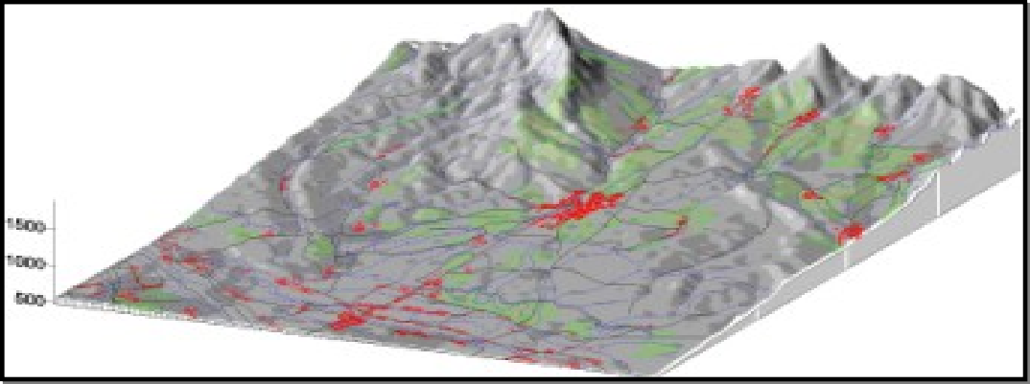
Agriculture
Farm management
Pest/Disease tracking
Crop monitoring
Yield prediction
Soil analysis

Slide 21
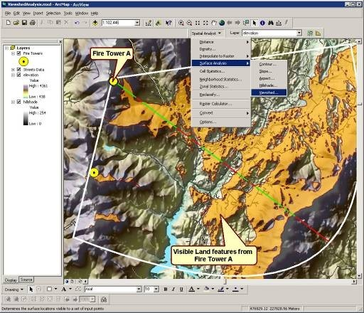
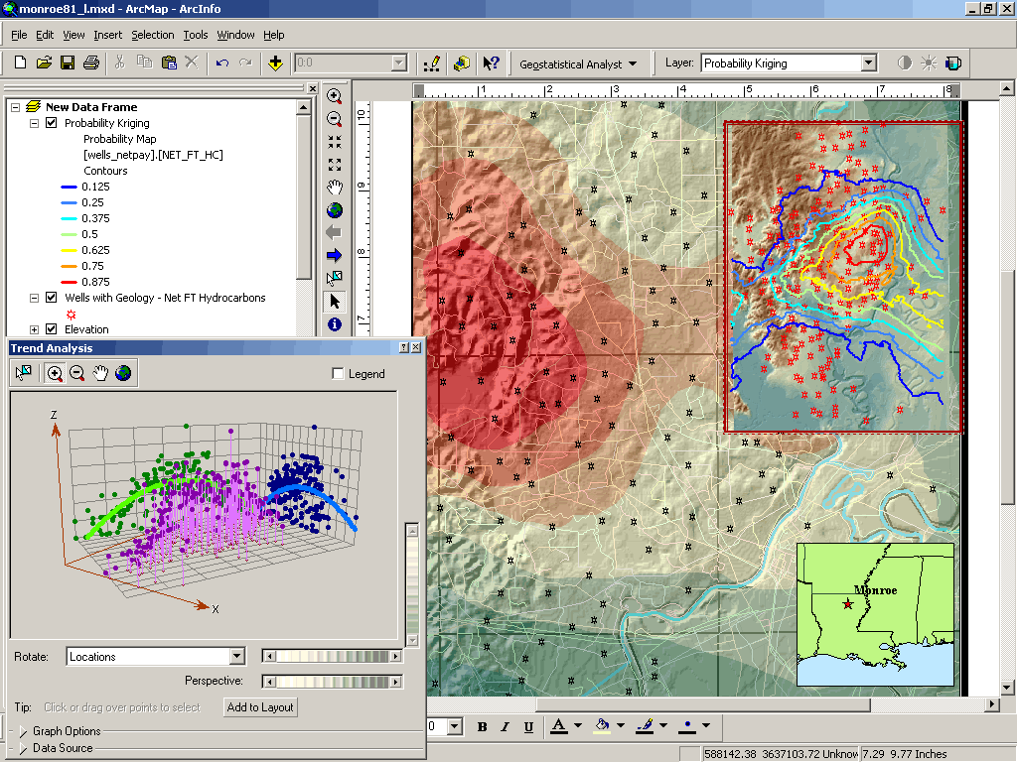
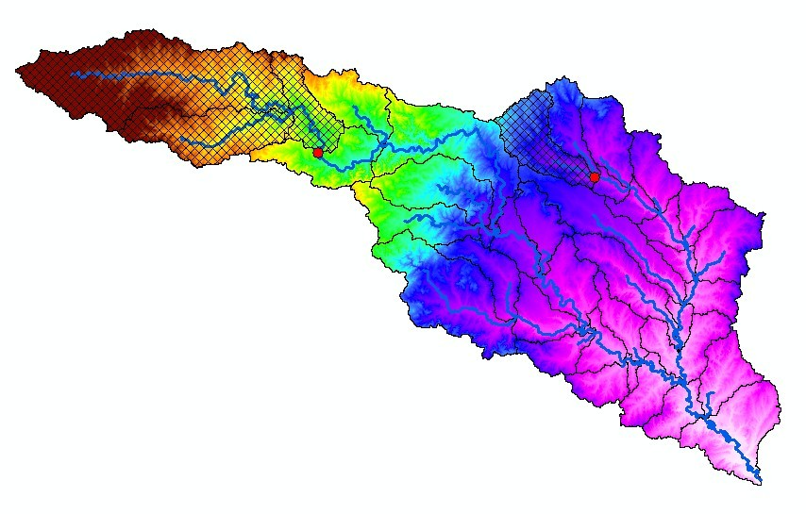
Natural Resource Management
Forestry
Ecology
Mining
Petroleum
Water Resources

Slide 22
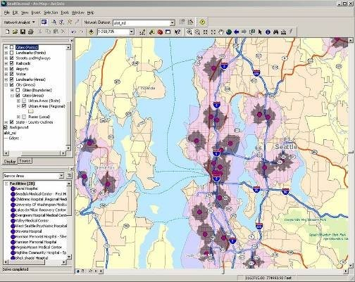
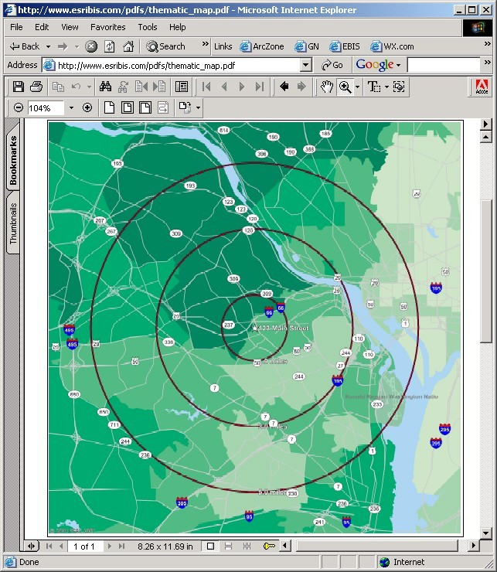
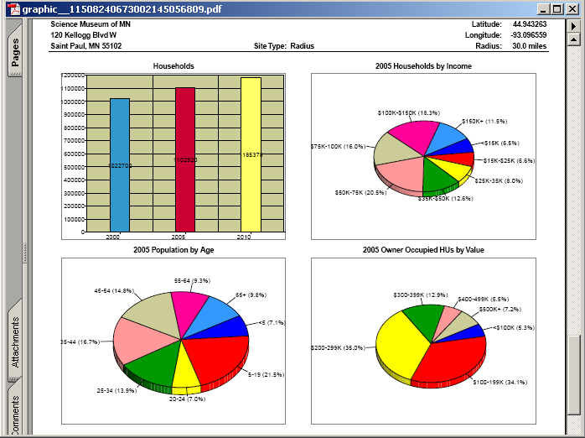
Planning and
Economic Development
Land Use/Zoning
Emergency Preparedness
Population Forecast
Market Analysis
Property Tax Assessment
Transportation

Slide 23

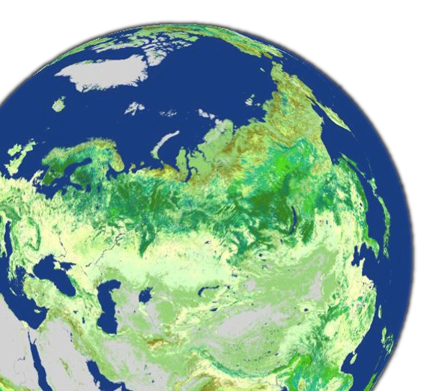


GIS: A Framework for Understanding and Managing Our Earth
Geographic Knowledge
Creating
Measuring
Organizing Analyzing Modeling
Holistic Comprehensive Systematic Analytic
Visual
Applying
Planning Managing Acting

Slide 24
Geography matters
Today’s challenges require geographic approach
•
•
•
•
•
•
•
•
Climate Change Urban Growth
Sustainable Agriculture Water Quality and Availability
International and National Security
Energy
Epidemiology/Disease Tracking
Natural Hazards: Seismicity, Weather Events

Slide 25
GIS as Infrastructure
Because GIS is used in many departments, coordination is needed
Software licensing
Instruction
Data

Slide 26
GIS as infrastructure
Data is greatest expense
Previously: Data scattered in multiple departments, not coordinated
Future: Data accessible anywhere, GIS portal and Web services facilitate sharing
Libraries / Data Centers key
GIS data has unique characteristics

Slide 27
Civil Engineering Applications
Transportation
Watershed analysis
Remote sensing
Fundamentals of GIS

Slide 28
Location-Allocation Inputs
Customer or demand locations
Potential site locations and/or existing facilities
Street network or Euclidean distance
The problem to solve
Fundamentals of GIS

Slide 29
Location-Allocation Outputs
The best sites
The optimal allocation of demand locations to those sites
Lots of statistical and summary information about that particular allocation
Fundamentals of GIS

Slide 30
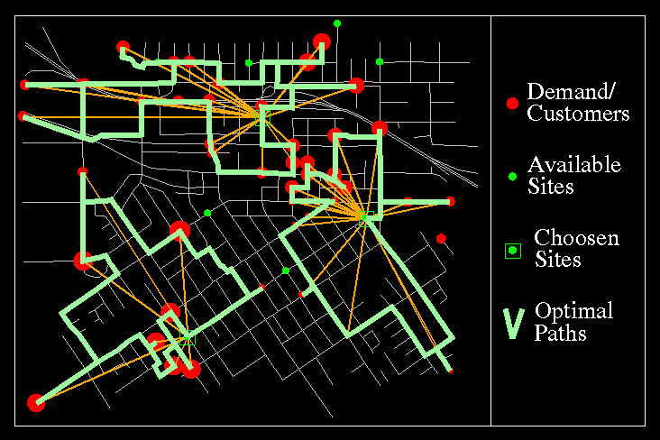
Vehicle Routing
(From , ESRI)
Fundamentals of GIS

Slide 31
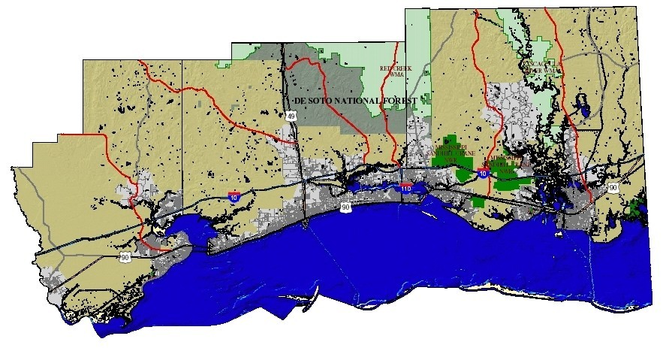
Other Transportation Applications
Planning & locating new roadway corridors
(from NCRST-E)
Fundamentals of GIS

Slide 32
Transportation – Emergency Operations
Transportation maps are critical
Disaster response plans can be developed
Outside computer models used for advance warnings
Land use maps enhance emergency operations
Fundamentals of GIS

Slide 33
Watershed
Characterization
Relate physical characteristics to water quality & quantity
Data – land use & land cover, geology, soils, hydrography & topography – related to hydrological properties
Fundamentals of GIS

Slide 34
Watershed
Applications
Estimate the magnitude of high-
flow events, the probability of low- flow events
Determine flood zones
Identify high-potential erosion areas
For example, BASINS, HEC-RAS, MIKE11 models integrated with
GIS
Fundamentals of GIS

Slide 35
GIS DATA AND SOURCES

Slide 36
Data Structure
GIS
GRAPHIC
ALPHA NUMERIC
SPATIAL
NON-SPATIAL/
NON-SPATIAL/
ATTRIBUTE
ATTRIBUTE
VECTOR
RASTER
CO-ORDINATE
IMAGE
SYSTEM
AREAL PHOTOGRAPH
REMOTE SENSED SCANNED IMMAGES

Slide 37
Maps And Map Elements
Maps are graphic representation of our perception of the world around us. They represent cartographic interpretation and simplification of reality.
Maps provide two types of information
o o
Locational information Spatial Relationships

Slide 38
Maps contains features such
as………
Point, Line, Area and Surface
Maps contain POINT features, LINE features and AREA features
Point Features :- wells, control points, sample sites, fire stations
Line Features :- roads, hydro lines, rivers, contour lines,
Area Features:-urban areas, water bodies, soil/rock units, forest areas

Slide 39

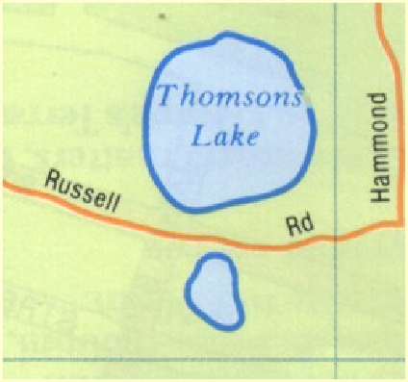
Point Features
Spatially distributed entities, activities or events
Points have a single geographic coordinate such as:
Tree
Traffic accident
Lamp post

Slide 40
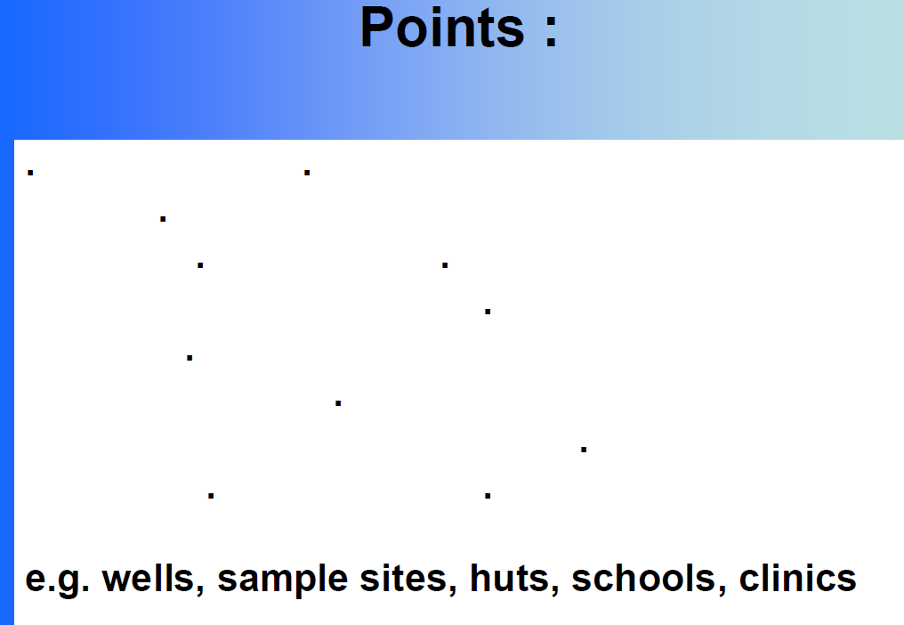

Slide 41

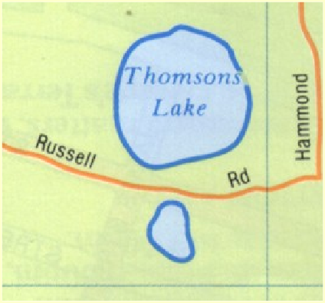
Line Features
Spatially distributed entities, activities or events
Lines (Arcs) are a series of geographic coordinates joined to form a line such as:
Road
Stream
Railway

Slide 42
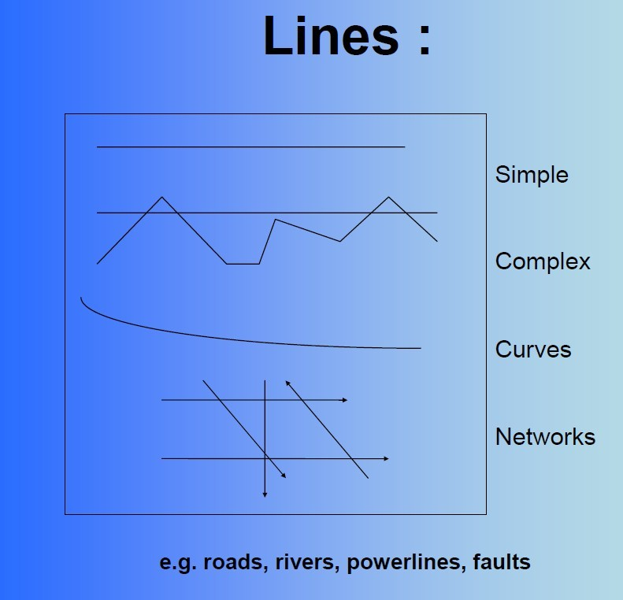

Slide 43

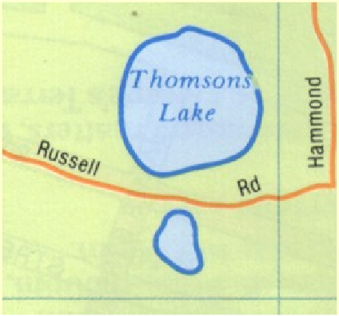
Area Features
Spatially distributed entities, activities or
o events
Areas (Polygons) are a series of geographic coordinates joined together to form a boundary such as:
Lake
Soil types

Slide 44
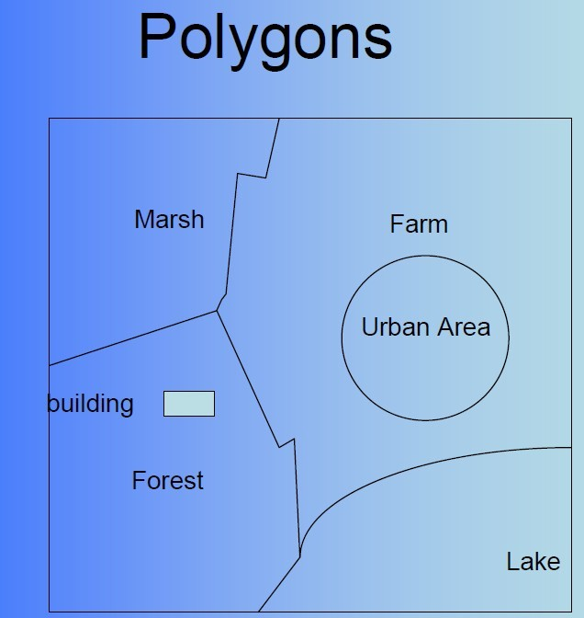

Slide 45
GIS Data Formats
There are two formats used by GIS systems to store and retrieve geographical data:
Raster
Vector

Slide 46
SPATIAL DATA
Raster
Vector
Data Model And Structure
RASTER MODEL
VECTOR MODEL

Slide 47
Raster Format
Data are divided into cell, pixels, or elements
Cells are organized in arrays
Each cell has a single value
Row and Column Numbers are used to identify the location of the cell within the array.
Perhaps the most common example of raster data is a digital image.

Slide 48
Raster Data
θA grid (or raster) system stores data as a string of characters in which each character represents a location.
θThe basic data unit is a cell or Pixel Each cell/Pixel is assigned only one value
θAn array of Pixels form the entity-Point, Line, Area and surface
θThe shape and size of the array determines the basic Resolution
θPolygons can be formed indicating areas of homogeneous characteristics

Slide 49
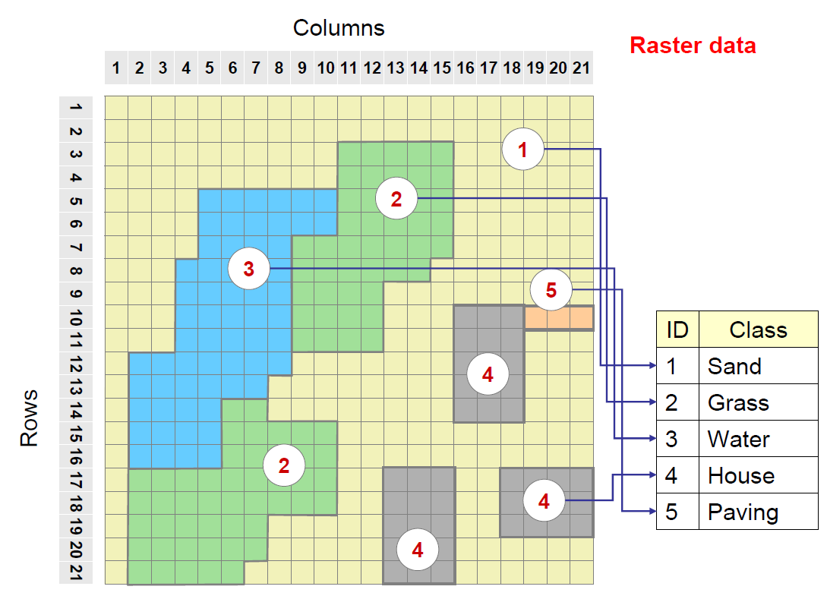

Slide 50
Vector Format
Data are associated with points, lines, or boundaries enclosing areas
Points are located by coordinates
Lines are described by a series of connecting vectors (line segments described by the coordinates of the start of the vector, its direction, and magnitude or length).
Areas or polygons are described by a series of vectors enclosing the area.

Slide 51
Vector Format
Any number of factors or attributes can be associated with a point line or polygon.
Data are stored in two files:
a file containing location information
a file containing information on the attributes
A third file contains information needed to link positional data with their attributes.

Slide 52
Vector Data
θA vector system usually stores data as coordinates.
θFor example Each uniform area is surrounded by a set of straight line segments called vectors.
θIn a vector based system every point is recorded by a pair of x and Y coordinates.
θStraight line segments called vectors are displayed to indicate line based data ( roads rivers wells)
θThe x-y coordinates at the end of each vector can be digitized and stored.
θMost spatial features can be displayed as: - Points- Line- Polygons

Slide 53
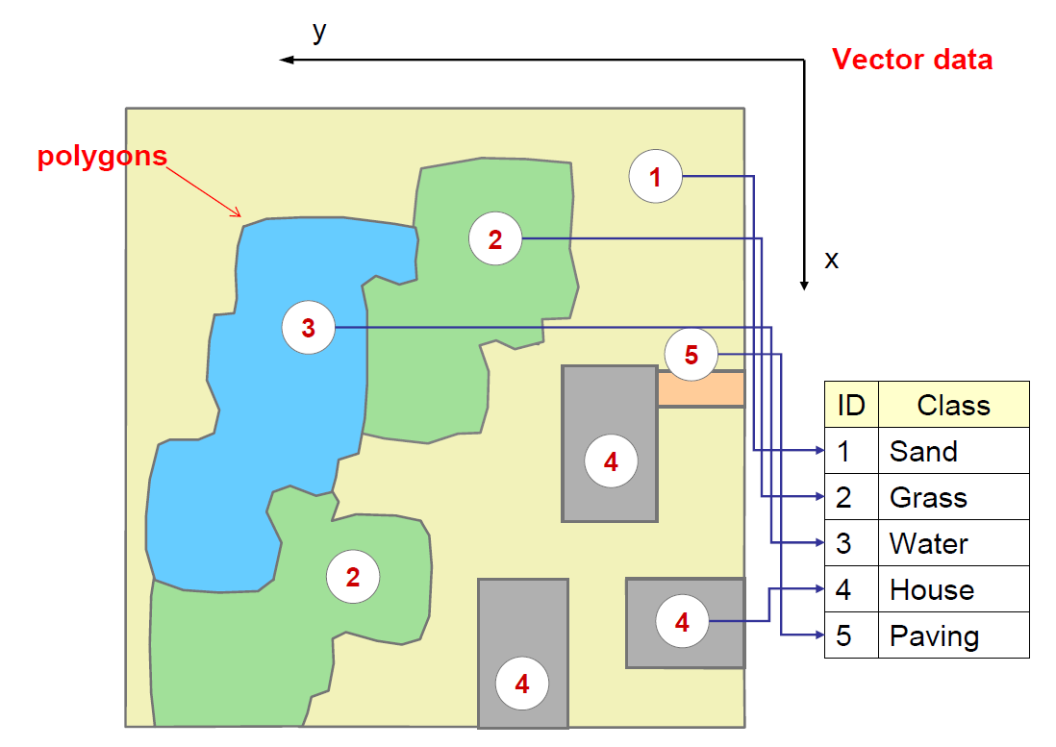

Slide 54


Vector and Raster Representation of Point Map Features
GIS Vector Format
Map Feature
GIS Raster Format
(X,Y)
Coordinate in space
Cell Located in an Array

Slide 55

Vector and Raster Representation of Line Map Features
GIS Vector Format
GIS Raster Format
Map Feature

Slide 56


Vector and Raster Representation of Area Map Features
GIS Vector Format
GIS Raster Format
Map Feature

Slide 57
Comparison of Raster and Vector Formats
Raster
Raster formats are efficient when comparing information among arrays with the same cell size.
Vector
Vector formats are efficient when comparing information whose geographical shapes and sizes are different.
Vector files are much smaller because a relatively small number of vectors can precisely describe large areas and a many attributes can be ascribed to these areas.
•
•
•
Raster files are generally very large because each cell occupies a separate line of data, only one attribute can be assigned to each cell, and cell sizes are relatively small.
•

Slide 58
Comparison of Raster and Vector Formats
Raster
Raster representations are relatively coarse and imprecise
Vector
Vector representations of shapes can be very precise.
•
•
Most GIS software can display both raster and vector data. Only a limited number of programs can analyze both types of data or make raster type analyses in vector formats.

Slide 59
Attribute
θAttributes caDn bae tnuameric or alfa-numeric
data that is assigned to a point, line or area spatial features
θExample Attributes…
Stand ID, Compartment No., Vegetation type, Name of the Forest Block, Types of Road, VSS code etc.,

Slide 60
NATURE OF SPATIAL DATA
(GEOGRAPHIC OBJECTS)
•
spatial component
relative position between objects
coordinate system
•
attribute component
– explains spatial objects characteristics
•
spatial relationship
– relationship between objects
•
time component
– temporal element

Slide 61
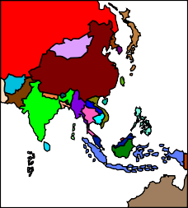






Maps and
Plans
Digital data
Paper files
Data
GIS
Photogrammetry
Data
Data
Interviews
Data
Remote Sensing
Field survey
GIS Data Sources

Slide 62
DATA SOURCES
•
Existing data
digital
map and plan
paper files
low cost
•
acquisition
remote sensing
photogrammetry
field survey
high cost

Slide 63
DATA ACQUISITION
•
spatial component can be obtained by
remote sensing
photogrammetry
survey
•
attribute component can be obtained by
remote sensing/photogrametry
interviews
field visit

Slide 64
ATTRIBUTE COMPONENT
•
retype from maps, plans or hardcopy files
•
copied from existing digital data

Slide 65
SPATIAL ACCURACY
•
Precision - indicates how closely several positions fall
in relation to each other
•
Accuracy - is a measure of the closeness of one or
more positions to a position that is known and defined in terms of an absolute reference system.

